Slide 1
Resources
Traditional Energy Conventional Energy
Wood Coal
Field Crops Oil
Fecal Material Natural Gas
Peat Nuclear

Slide 2
NON-Renewable Resources

Slide 3
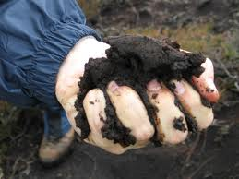
What is Peat?
Peat is an accumulation of partially decayed vegetation matter and is the first stage in the formation of coal
Peat forms in wetlands, variously called bogs, moors, muskegs, pocosins, mires, and swamps
It contains a large amount of water and must be dried before use
Historically, it has been used as a source of heat and burns with a long flame and considerable smoke

Slide 4
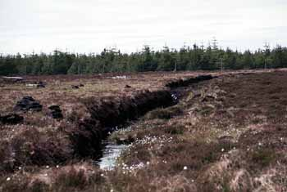
Where is Peat mined?
Peat deposits are found in many places around the world, notably in Russia, Ireland, Finland, Scotland, Poland, northern Germany, the Netherlands and Scandinavia, and in North America
Approximately 60% of the world's wetlands have peat

Slide 5
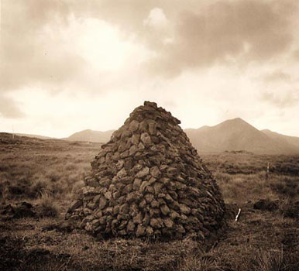
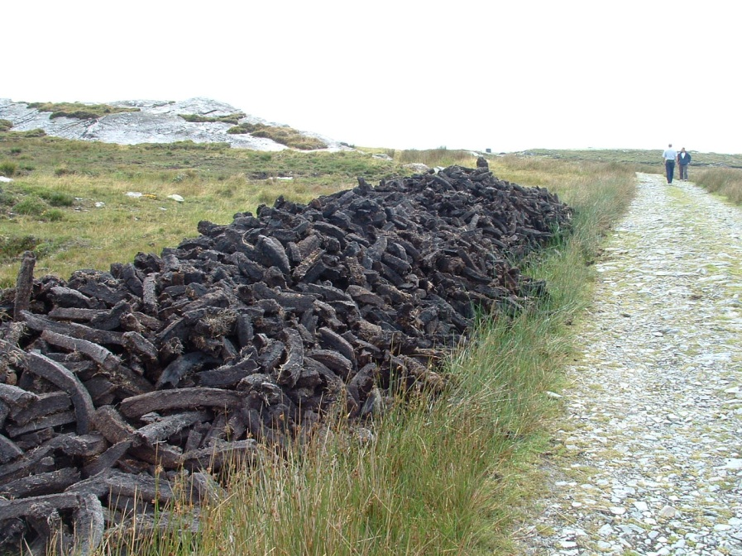
Peat
Peat is still mined as a fuel in Ireland and England
The peat is stacked to slowly dry out

Slide 6
What Are the Advantages and Disadvantages of Oil?
Conventional oil is currently abundant, has a high net energy yield, and is relatively inexpensive, but using it causes air and water pollution and releases greenhouse gases to the atmosphere.
Heavy oils from oil sand and oil shale exist in potentially large supplies but have low net energy yields and higher environmental impacts than conventional oil has.

Slide 7
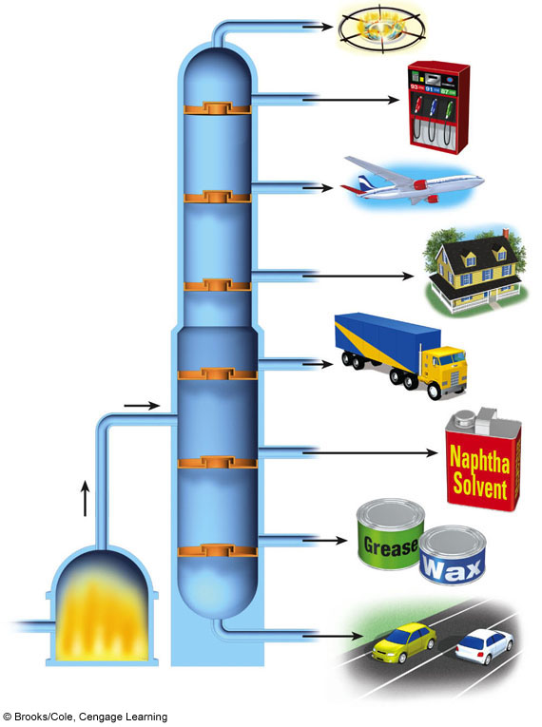
Lowest Boiling Point
Gases
Gasoline
Aviation fuel
Heating oil
Diesel oil
Naphtha
Grease and wax
Heated crude oil
Asphalt
Furnace
Highest Boiling Point
Fig. 15-4a, p. 375
Notes:
Figure 15.4
Science: refining crude oil. Components of petroleum are removed at various levels, depending on their boiling points, in a giant distillation column. The most volatile components with the lowest boiling points are removed at the top of the column. The photo shows an oil refinery in the U.S. state of Texas.

Slide 8
Who controls the Oil Prices?
OPEC Controls Most of the World’s Oil Supplies
13 countries have at least 60% of the world’s crude oil reserves
Saudi Arabia: 25%
Canada: 15%
Oil production peaks and flow rates to consumers

Slide 9
The United States Uses Much More Oil Than It Produces
Produces 9% of the world’s oil
Imports 60% of its oil
About One-fourth of the world’s conventional oil is controlled by countries that sponsor or condone terrorism

Slide 10
What are the Advantages and Disadvantages of Conventional Oil?
Extraction, processing, and burning of nonrenewable oil and other fossil fuels
Advantages
Disadvantages

Slide 11
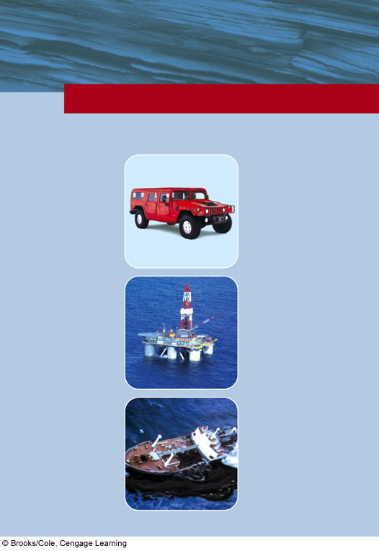
TRADE-OFFS
Conventional Oil
Advantages
Disadvantages
Ample supply for 42–93 years
Need to find substitutes within 50 years
Low cost
Large government subsidies
High net energy yield
Environmental costs not included in market price
Easily transported within and between countries
Artificially low price encourages waste and discourages search for alternatives
Low land use
Pollutes air when produced and burned
Technology is well developed
Releases CO₂ when burned
Efficient distribution system
Can cause water pollution
Fig. 15-6, p. 379
Notes:
Figure 15.6
Advantages and disadvantages of using conventional crude oil as an energy resource (Concept 15-2A). Question: Which single advantage and which single disadvantage do you think are the most important? Why?

Slide 12
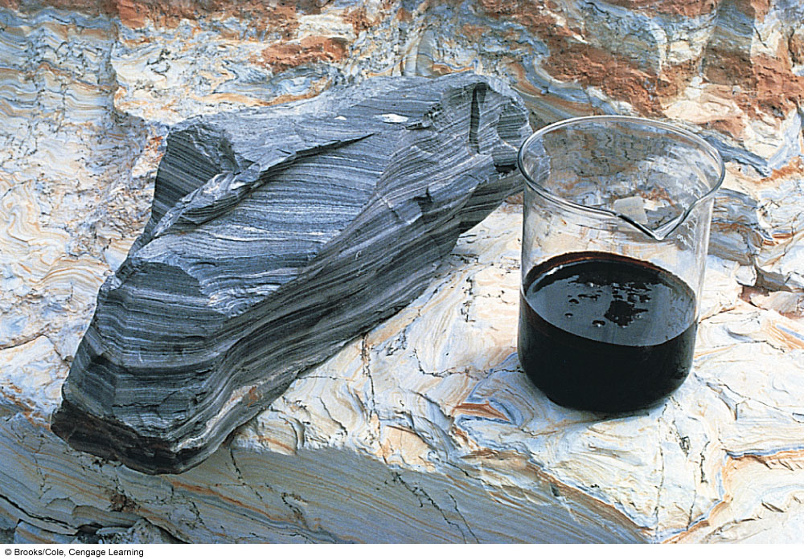
Oil Shale Rock and the Shale Oil Extracted from It

Slide 13
What Are the Advantages and Disadvantages of Natural Gas?
Conventional natural gas is more plentiful than oil, has a high net energy yield and a fairly low cost, and has the lowest environmental impact of all fossil fuels.

Slide 14
TRADE-OFFS
Conventional Natural Gas
Advantages
Disadvantages
Ample supplies
Nonrenewable resource
High net energy yield
Releases CO₂ when burned
Low cost
Less air pollution than other fossil fuels
Gas turbine
Government subsidies
Environmental costs not included in market price
Lower CO₂ emissions than other fossil fuels
Methane (a greenhouse gas) can leak from pipelines
Easily transported by pipeline
Difficult to transfer from one country to another
Low land use
Good fuel for fuel cells, gas turbines, and motor vehicles
Can be shipped across ocean only as highly explosive LNG
Fig. 15-10, p. 382
Notes:
Figure 15.10
Advantages and disadvantages of using conventional natural gas as an energy resource (Concept 15-3). Question: Which single advantage and which single disadvantage do you think are the most important? Why?

Slide 15
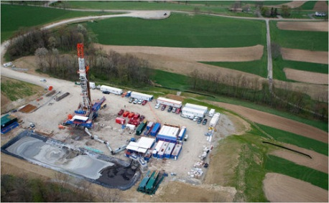
What is Hydraulic Fracturing?
Hydraulic fracturing, or fracking, is a technology used in drilling for oil and natural gas.
(ohiocitizen.org)

Slide 16
What is Hydraulic Fracturing?
(Propublica.org)

Slide 17
What Are the Advantages and Disadvantages of Coal?
Conventional coal is very plentiful and has a high net energy yield and low cost, but it has a very high environmental impact.
Gaseous and liquid fuels produced from coal could be plentiful, but they have lower net energy yields and higher environmental impacts than conventional coal has.

Slide 18
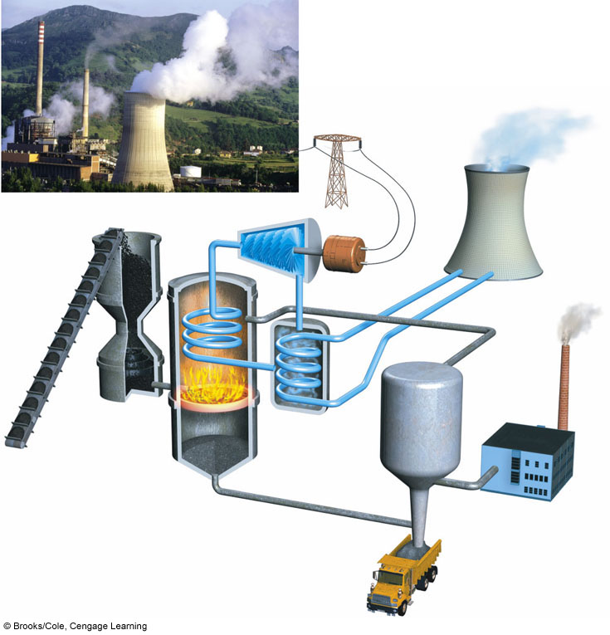
Waste heat
Coal bunker
Turbine
Cooling tower transfers waste heat to atmosphere
Generator
Cooling loop
Stack
Pulverizing mill
Condenser
Filter
Boiler
Toxic ash disposal
Fig. 15-12, p. 383
Notes:
Figure 15.12
Science: coal-burning power plant. Heat produced by burning pulverized coal in a furnace boils water to produce steam that spins a turbine to produce electricity. The steam is cooled, condensed, and returned to the boiler for reuse. Waste heat can be transferred to the atmosphere or to a nearby source of water. Water is pumped through a condenser and back to the water source to remove the waste heat. The largest coal-burning power plant in the United States is in Indiana. It burns 23 metric tons (25 tons) of coal per minute, or three 100-car trainloads of coal per day. The photo shows a coal-burning power plant in Soto de Ribera, Spain. Question: Does the electricity that you use come from a coal-burning power plant?

Slide 19
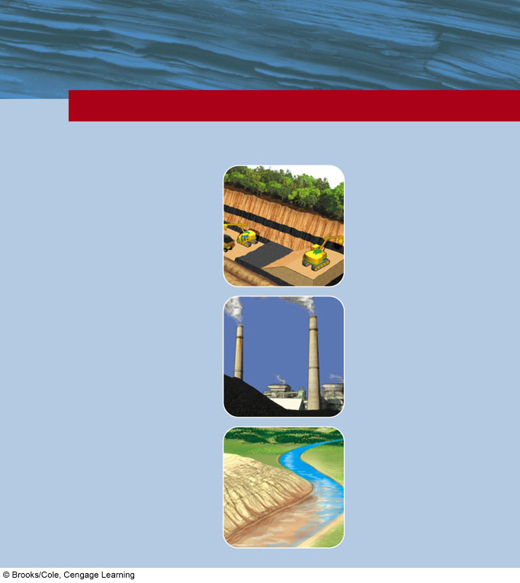
TRADE-OFFS
Coal
Advantages
Disadvantages
Ample supplies (225–900 years)
Severe land disturbance, air pollution, and water pollution
High net energy yield
Severe threat to human health when burned
Environmental costs not included in market price
Low cost
Large government subsidies
Well-developed technology
High CO₂ emissions when produced and burned
Air pollution can be reduced with improved technology
Radioactive particle and toxic mercury emissions
Fig. 15-15, p. 385
Notes:
Figure 15.15
Advantages and disadvantages of using coal as an energy resource (Concept 15-4A). Question: Which single advantage and which single disadvantage do you think are the most important? Why?

Slide 20
What Are the Advantages and Disadvantages of Nuclear Energy?
Nuclear power has a low environmental impact and a very low accident risk, but high costs, a low net energy yield, long-lived radioactive wastes, vulnerability to sabotage, and the potential for spreading nuclear weapons technology have limited its use.

Slide 21
How Does a Nuclear Fission Reactor Work? (1)
Controlled nuclear fission reaction in a reactor
Light-water reactors
Fueled by uranium ore and packed as pellets in fuel rods and fuel assemblies
Control rods absorb neutrons

Slide 22
How Does a Nuclear Fission Reactor Work? (2)
Water is the usual coolant
Containment shell around the core for protection
Water-filled pools or dry casks for storage of radioactive spent fuel rod assemblies
Notes:
22

Slide 23
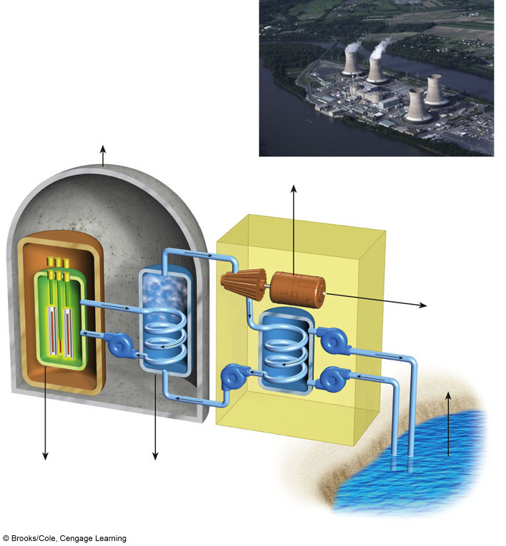
Small amounts of radioactive gases
Control rods
Containment shell
Heat exchanger
Waste heat
Steam
Turbine
Generator
Uranium
fuel input
(reactor core)
Hot coolant
Useful electrical energy
25%–30%
Hot water output
Pump
Pump
Shielding
Coolant
Pump
Pump
Waste heat
Moderator
Cool water input
Pressure vessel
Coolant passage
Water
Condenser
Periodic removal and storage of radioactive wastes and spent fuel assemblies
Periodic removal and storage of radioactive liquid wastes
Water source (river, lake, ocean)
Fig. 15-17, p. 387
Notes:
Figure 15.17
Science: light-water–moderated and –cooled nuclear power plant with a pressurized water reactor. Some nuclear plants withdraw water for cooling from a nearby source of water and return the heated water to such a source, as shown here. Other nuclear plants that do not have access to a source of cooling water transfer the waste heat to the atmosphere by using one or more gigantic cooling towers, as shown in the insert photo of the Three Mile Island nuclear power plant near Harrisburg, Pennsylvania (USA). Question: How does this plant differ from the coal-burning plant in Figure 15-12?

Slide 24
What Is the Nuclear Fuel Cycle?
Mine the uranium
Process the uranium to make the fuel
Use it in the reactor
Safely store the radioactive waste
Decommission the reactor

Slide 25
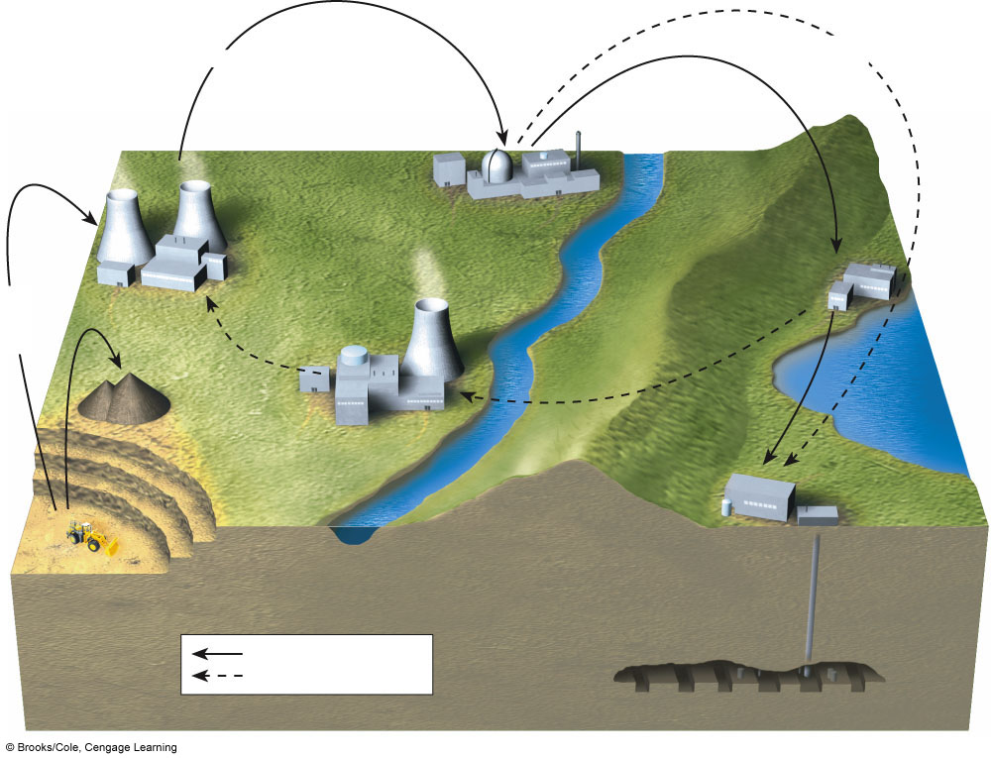
Fuel assemblies
Decommissioning of reactor
Enrichment of UF₆
Reactor
Fuel fabrication
(conversion of enriched UF₆ to UO to UO₂ and fabrication of fuel assemblies)
Temporary storage of spent fuel assemblies underwater or in dry casks
Conversion of U₃O₈
to UF₆
Uranium-235 as UF₆ Plutonium-239 as PuO₂
Spent fuel reprocessing
Low-level radiation with long half-life
Geologic disposal of moderate- and high-level radioactive wastes
Open fuel cycle today
Recycling of nuclear fuel
Fig. 15-19, p. 389
Notes:
Figure 15.19
Science: the nuclear fuel cycle (Concept 15-5). As long as a plant is operating safely, this fuel cycle has a fairly low environmental impact and a very low risk of an accident. But costs are high, radioactive wastes must be stored safely for thousands of years, and facilities are vulnerable to terrorist attack. Also, the technology can be used to produce material for use in nuclear weapons, and an amount equal to about 92% of the energy content of the nuclear fuel is wasted in producing nuclear power. Questions: Do you think the market price of nuclear-generated electricity should include all the costs of the fuel cycle? Explain. If so, how would this affect the use of nuclear power to produce electricity?

Slide 26
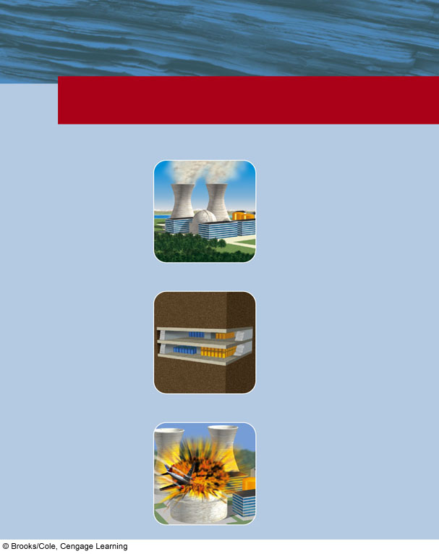
TRADE-OFFS
Conventional Nuclear Fuel Cycle
Advantages
Disadvantages
Large fuel supply
Cannot compete economically without huge government subsidies
Low environmental impact (without accidents)
Low net energy yield
High environmental impact (with major accidents)
Emits 1/6 as much CO₂ as coal
Moderate land disruption and water pollution (without accidents)
Environmental costs not included in market price
Risk of catastrophic accidents
Moderate land use
No widely acceptable solution for long-term storage of radioactive wastes
Low risk of accidents because of multiple safety systems (except for Chernobyl-type reactors)
Subject to terrorist attacks
Spreads knowledge and technology for building nuclear weapons
Fig. 15-21, p. 391
Notes:
Figure 15.21
Advantages and disadvantages of using the nuclear power fuel cycle (Figure 15-19) to produce electricity (Concept 15-5). Question: Which single advantage and which single disadvantage do you think are the most important? Why?

Slide 27
Will Nuclear Fusion Save Us?
“Nuclear fusion is the power of the future and always will be”
Still in the laboratory phase after 50 years of research and $34 billion dollars
2006: U.S., China, Russia, Japan, South Korea, and European Union
Will build a large-scale experimental nuclear fusion reactor by 2040

